Slide 1

Screenshot

Slide 2
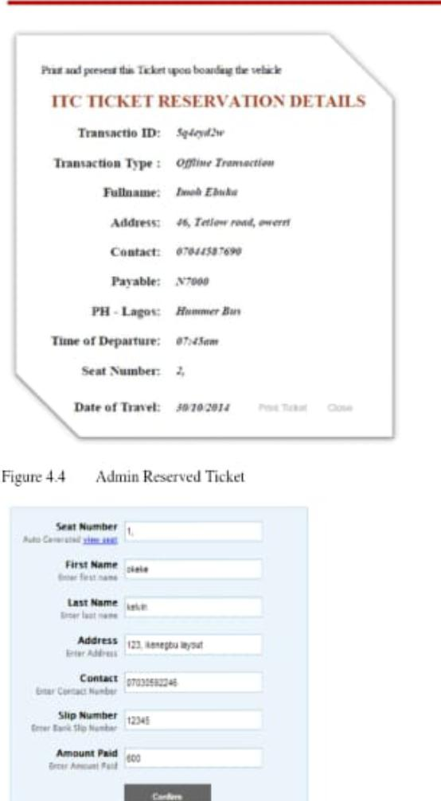

Slide 3
